Slide 1

Chapter 4
Digital
Transmission

Slide 2
Chapter 4: Outline
4.1 DIGITAL-TO-DIGITAL CONVERSION
4.2 ANALOG-TO-DIGITAL CONVERSION
4.3 TRANSMISSION MODES

Slide 3
Chapter 4: Objective
The first section discusses digital-to-digital conversion. Line coding is used to convert digital data to a digital signal. Several common schemes are discussed. The section also describes block coding, which is used to create redundancy in the digital data before they are encoded as a digital signal. Redundancy is used as an inherent error detecting tool. The last topic in this section discusses scrambling, a technique used for digital-to-digital conversion in long-distance transmission.
The second section discusses analog-to-digital conversion. Pulse code modulation is described as the main method used to sample an analog signal. Delta modulation is used to improve the efficiency of the pulse code modulation.

Slide 4
Chapter 4: Objective
The third section discusses transmission modes. When we want to transmit data digitally, we need to think about parallel or serial transmission. In parallel transmission, we send multiple bits at a time; in serial transmission, we send one bit at a time.

Slide 5
4.1 DIGITAL-TO-DIGITAL CONVERSION
Digital to Digital Conversion
  How we can represent digital data by using digital signals?
  The conversion involves three techniques: line coding, block coding, and scrambling.
  Line coding is always needed; block coding and scrambling may or may not be needed.
Line coding의 문제를 해결하기 위하여 데이터 자체를 약간 변환함
Topics discussed in this section:
4.1.1 Line Coding ➔
4.1.2 Line Coding Scheme
4.1.3 Block Coding
4.1.4 Scrambling
conversion digital data to digital signals.
➔
Adding some redundancy bit in the digital data
➔
Inserting some pulse for long-distance transmission

Slide 6
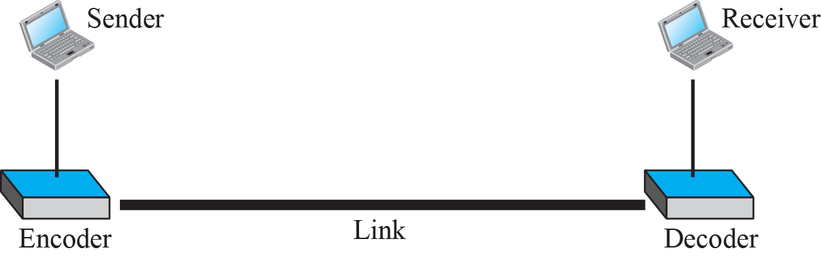
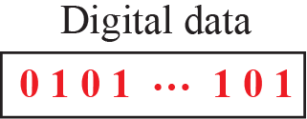
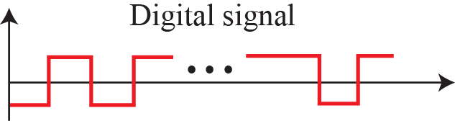
4.1.1 Line Coding
Line Coding
  It is the process of converting digital data to digital signals.
  At the sender, digital data are encoded into a digital signal.
  At the receiver, the digital data are recreated by decoding the digital signal.

Slide 7
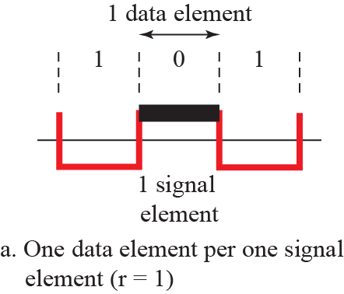
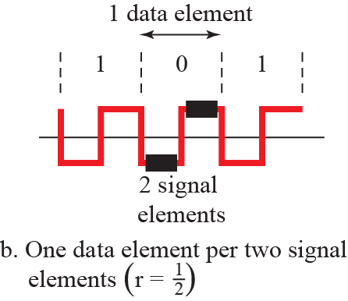
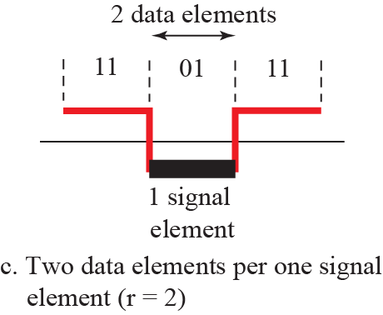
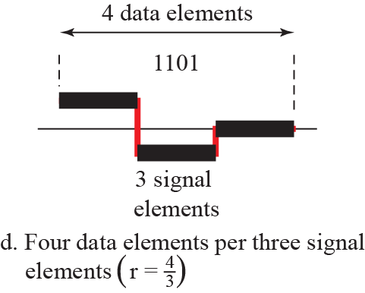
4.1.1 Line Coding
Signal elements versus data elements
r is number of bit
per one signal element

Slide 8
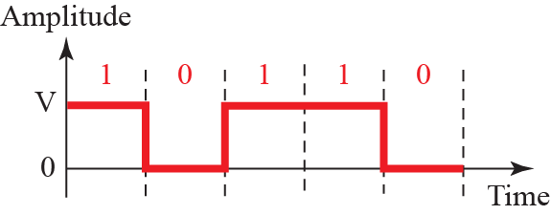
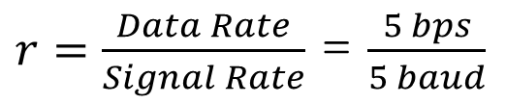
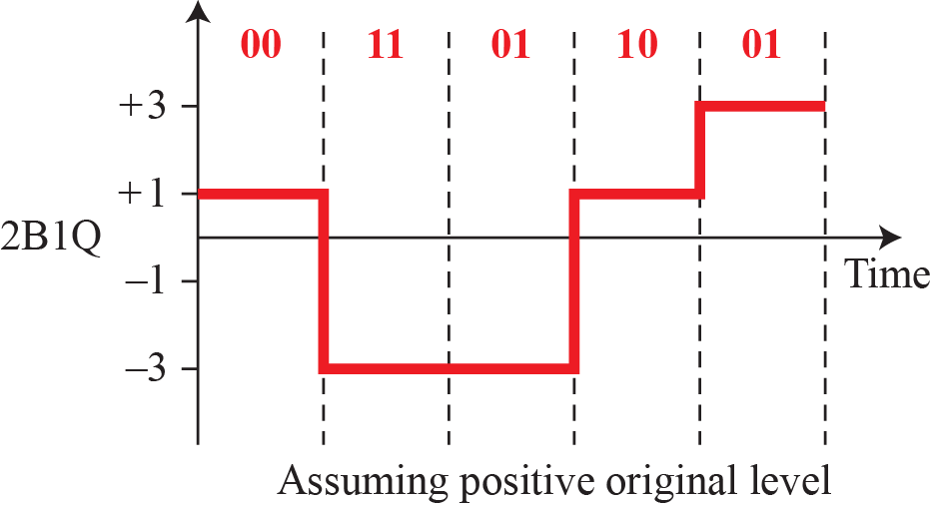
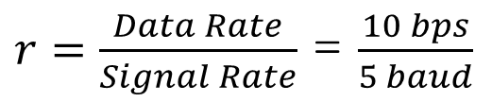

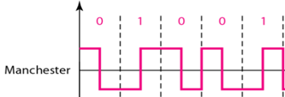
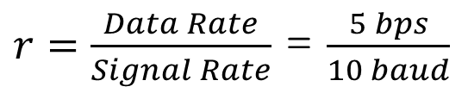
4.1.1 Line Coding
Signal Rate & Data Rate
1sec
r = log₂ L

Slide 9

4.1.1 Line Coding
Signal Rate과 Data rate
  Data Rate – bit rate
    The number of bit sent in 1s. (unit : bps)
  Signal Rate – baud rate, modulation rate, pulse rate
    The number of signal element sent in 1s. (unit : baud)
  Increase data rate while decreasing signal rate.
    Data Rate ↑ Transmission speed ↑
    Signal Rate ↓ Bandwidth ↓
  Relationship between data rate and signal rate
    S = N / r
    S(baud) = C(Case factor) X N(bps) X
    r = number of bit per one signal element
➔
➔

Slide 10
Example 4.1
One data element is encoded as one signal element.
If the bit rate is 100 kbps and c is between 0 and 1, what is the average value of the baud rate?
Solution
Assuming that the average value of c is ½ , the baud rate is

Slide 11
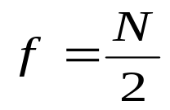
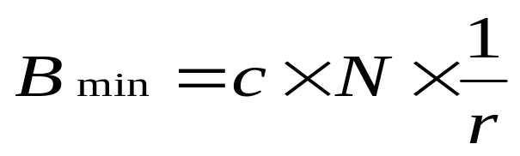
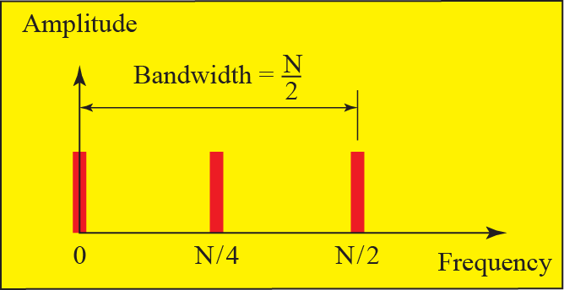
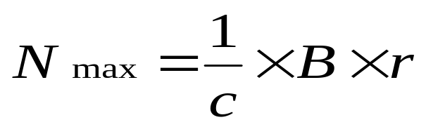

4.1.1 Line Coding
Bandwidth
Although the actual bandwidth of a digital signal is infinite, the effective bandwidth is finite.
The bandwidth is proportional to the signal rate (buad rate).
Required Bandwidth
  Minimum Bandwidth
  Maximum Data Rate

Slide 12

Example 4.2
The maximum data rate of a channel is defined by the Nyquist formula as following :
N_{max} = 2× B× log₂ L
Does this agree with the previous formula for N_{max} ?
Solution
A signal with L levels can carry log₂L bits per level.
If each level corresponds to one signal element and we assume the average case (c = 1/2),we have following formula :
r = log₂ L

Slide 13
4.1.1 Line Coding
Base Line
  In a decoding a digital signal, the receiver calculates an average of the received signal power.
  This average is called base line.
  To determine the value 0 or 1, the incoming signal power is evaluated against this baseline.
Baseline Wandering
  A long string of 0s or 1s can cause a drift in the baseline(Baseline Wandering).
  ➔ difficult to decode correctly.
  A good line coding scheme needs to prevent baseline wandering.

Slide 14
4.1.1 Line Coding
DC Component
  When the voltage level is constant, the signal creates very low frequencies.
  The frequencies around zero are called DC(Direct Current) component.
The Problems of DC Component
  A system (line or device) cannot operate on very low frequencies.
    The telephone line cannot pass below 200kHz.
    A long distance link may use one or more transformers.
  We need a scheme with no DC component.

Slide 15
4.1.1 Line Coding
Self Synchronization
  The receiver’s bit intervals must correspond exactly to the sender’s bit intervals.
  A self synchronization digital signal includes timing information in the data being transmitted.
  This can be achieved by the transitions in the signal to alert the receiver.
No Self Synchronization
With Self Synchronization

Slide 16
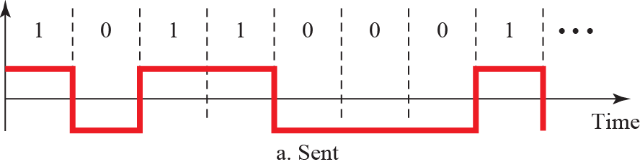
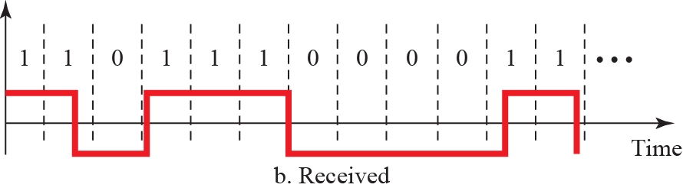
4.1.1 Line Coding
Effect of lack of Synchronization
분리된 또 하나의 채널로 별도의 타이밍 신호를 보내서 동기화 가능
동기화 보장을 위해 각 신호마다 동기화 정보를 포함

Slide 17
Example 4.3
In a digital transmission, the receiver clock is 0.1 percent faster than the sender clock.
How many extra bits per second does the receiver receive if the data rate is 1 kbps?
How many if the data rate is 1 Mbps?
Solution
At 1 kbps, the receiver receives 1,001 bps instead of 1,000 bps.
At 1 Mbps, the receiver receives 1,001,001 bps instead of 1,000,000 bps.

Slide 18
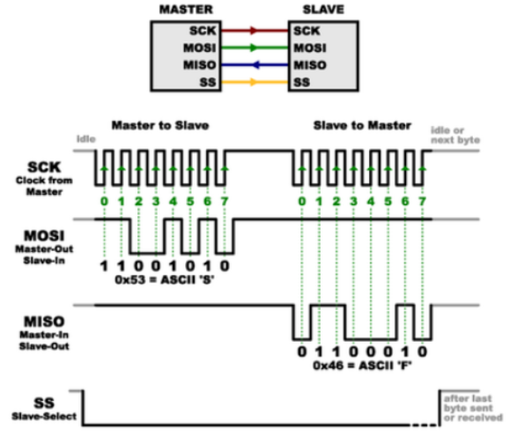
SPI(Serial Peripheral Interface) Communication
a synchronous serial communication interface used for short-distance communication
별There is a wire for synchronization clock.
  Serial Clock
  Master Output Slave Input
  Master Input Slave Output
  Slave Select

Slide 19
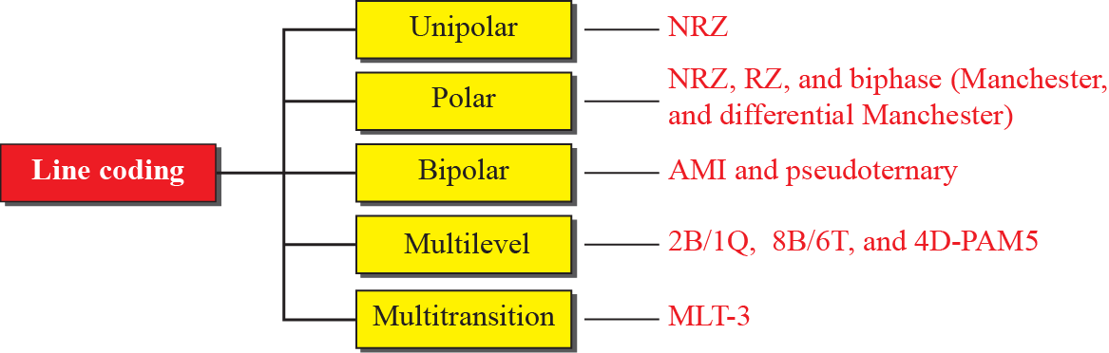
4.1.2 Line Coding Schemes
Line Coding Schemes

Slide 20
4.1.2 Line Coding Schemes
Check point of Line Coding Schemes
  Bandwidth : The scheme having narrow bandwidth with same speed is good.
  DC Components : The scheme having no DC components is good.
  Self-synchronization : The scheme having self-synchronization is good.

Slide 21
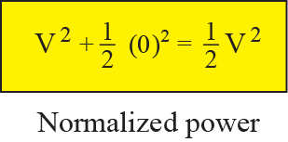
4.1.2 Line Coding Schemes
1. Unipolar Schemes
  All the signal level is uni-polar, either above or below 0v.
  NRZ(Non-Return-to-Zero) : Signal does not return to zero at the middle of the bit.

Slide 22
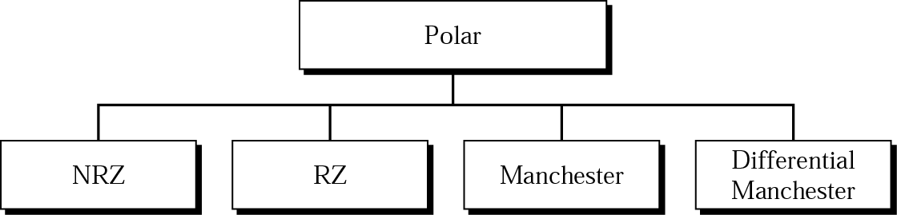
4.1.2 Line Coding Schemes
2. Polar Schemes
  Positive and Negative Voltage
  회선의 평균 전압 준위를 감소시켜 직류 성분 문제를 완화시킴
RZ(Return to Zero)

Slide 23
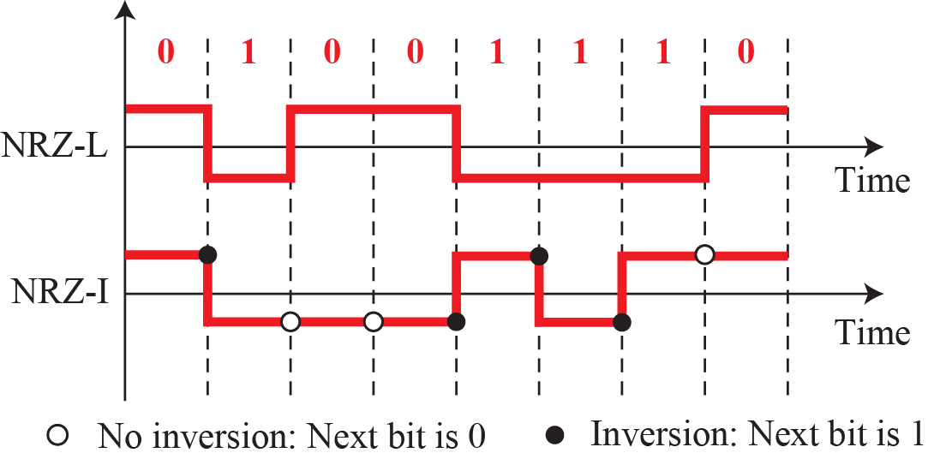
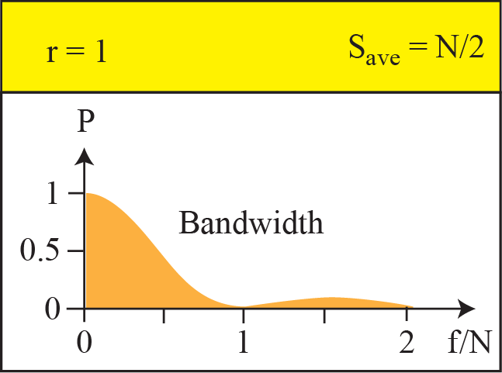
4.1.2 Line Coding Schemes
2. Polar schemes
  Non-Return-to-Zero (NRZ-L and NRZ-I)
    In NRZ-L, the level of the voltage determines the value of the bit.
    In NRZ-I, the inversion or the lack of inversion determines the value of the bit.
S = C X N(bps) X

Slide 24
4.1.2 Line Coding Schemes
2. Polar schemes
  Non-Return-to-Zero (NRZ-L and NRZ-I)
    Baseline Wandering
      A long sequence of 0s or 1s causes the average signal power to be skewed. ➔ difficulty discerning the bit value
      NRZ-L : occurs for a long sequence of 0s and 1s.
      NRZ-I : occurs only for a long sequence of 0s.
    Self Synchronization
      NRZ-L : Problems exists for bit 0 and 1.
      NRZ-I : No Problem for bit 1
    DC components
      NRZ-L and NRZ-I both have the DC Component problem.
    Average signal rate
      NRZ-L and NRZ-I both have N/2 Baud.

Slide 25
Example 4.4
A system is using NRZ-I to transfer 10-Mbps data.
What are the average signal rate and minimum bandwidth?
Solution
The average signal rate is S = N/2 = 500kbaud.
The minimum bandwidth for this average baud rate is
B_{min} = S = 500 kHz.

Slide 26
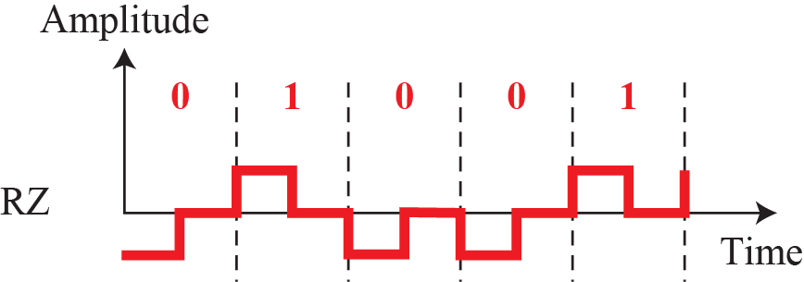
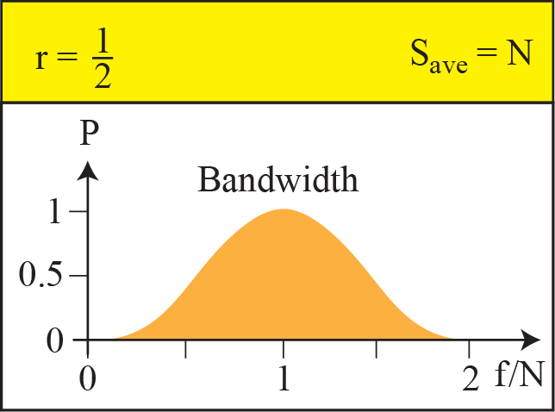
4.1.2 Line Coding Schemes
2. Polar schemes
② Return-to-Zero (RZ)
  use three value : positive, negative, zero
  The signal changes during the bit for self-synchronization.
  Bandwidth : It occupies greater bandwidth.
  DC components : None.
  Self-synchronization : Good
S = C X N(bps) X

Slide 27
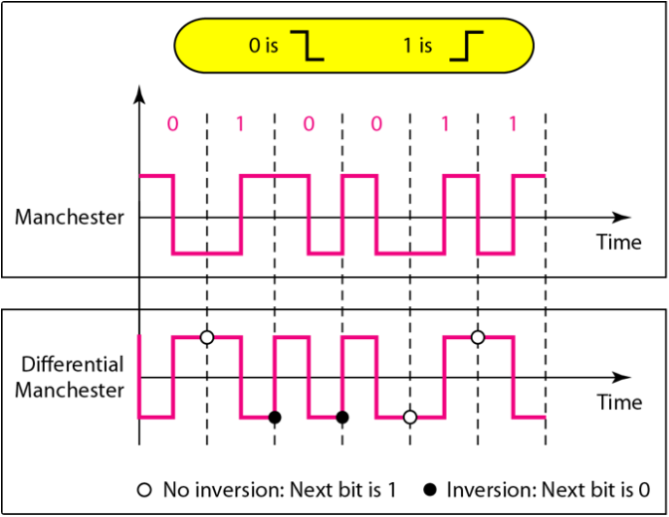
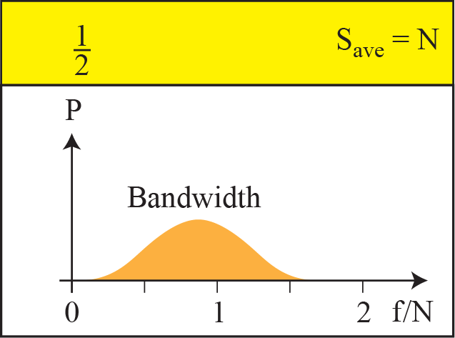
4.1.2 Line Coding Schemes
2. Polar schemes
  ③ Polar Biphase : Manchester and differential Manchester
    There is always a transition at the middle of the bit (0→1, 1→0).
S = C X N(bps) X

Slide 28
4.1.2 Line Coding Schemes
2. Polar schemes
  ③ Polar Biphase : Manchester and differential Manchester
    Bandwidth : It occupies greater bandwidth.
      Signal rate : Double that of NRZ
    Base line wondering : None
    DC Components : None.
    Self-synchronization : Good.
Manchester 와 Differential Manchester 는 비트 중간에서의 양→음 / 음 → 양 반전은 Synchronization을 위해 사용.

Slide 29
4.1.2 Line Coding Schemes
2. Polar schemes
  ③ Polar Biphase
    Manchester :
      The transition at the middle of the bit provides synchronization.
      - This scheme is used in Ethernet, Token Bus, IEEE 802.3.
    Differential Manchester :
      The bit values are determined at the beginning of the bit.
      If the next bit is 0, there is a transition.
      If the next bit is 1, there is no transition.
      - This scheme is used in Token Ring.

Slide 30
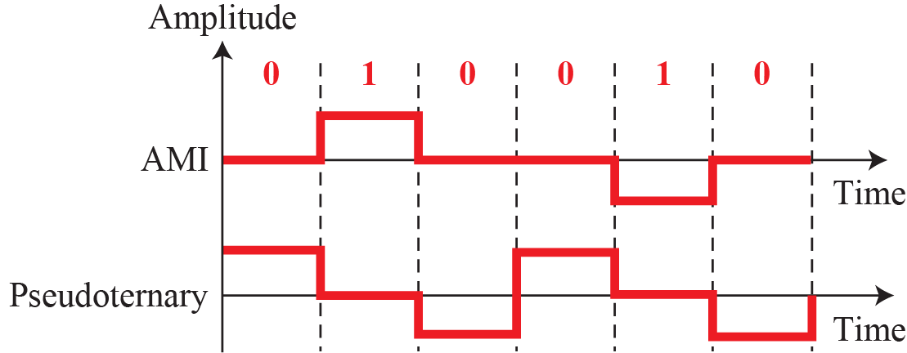
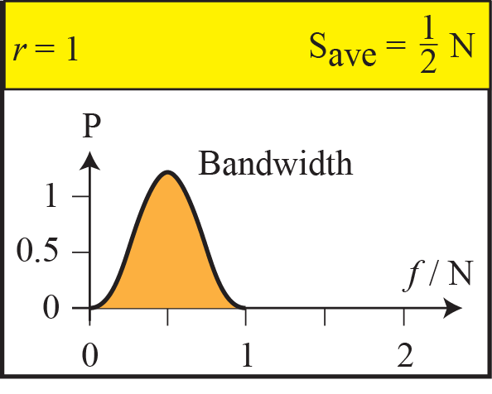
4.1.2 Line Coding Schemes
3. Bipolar Scheme
  we use three levels: positive, zero, and negative.
  AMI(Alternative Mark Inversion)
    - Bit 0 uses zero voltage level.
    - Bit 1 uses alternate voltage of plus and minus.
  Pseudoternary
    - Bit 1 uses zero voltage level.
    - Bit 0 uses alternate voltage of plus and minus.
S = C X N(bps) X

Slide 31
4.1.2 Line Coding Schemes
3. Bipolar Schemes
  Bandwidth : Good
  DC Components : None.
    The voltage level alternates between positive and negative for a long sequences of 1s.
    For a long sequences of 1s, its amplitude is zero.
  Self-synchronization : Bad.
    AMI is commonly used for long distance communication.
    A scrambling technique can solve this problem.

Slide 32
4.1.2 Line Coding Schemes
4. Multilevel Schemes
  mBnL schemes
    A pattern of m data elements is encoded as a pattern of n signal elements in which 2^{m} ≤ L^{n} .
      If 2^{m} ≤ L^{n}, data patterns occupy only a subset of signal patterns.
      Subset can be designed to prevent baseline wandering, to provide synchronization, and to detect error.
    The first two letters define signal pattern, and the last two define signal pattern .
      m : The length of binary pattern
      B : Binary
      n : The length of signal pattern
      L : number of signal level
      B(Binary), T(Ternary), Q(Quaternary)

Slide 33
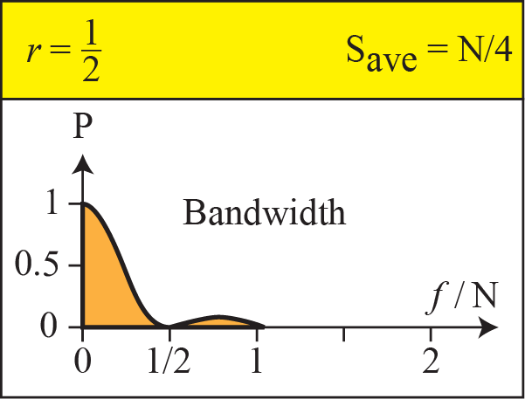

4.1.2 Line Coding Schemes
4. Multilevel Schemes
  ① 2B1Q (2 Binary, 1 Quaternary)
S = C X N(bps) X
2^{m} ≤ L^{n ➔} 2² ≤ 4¹
In mBnL scheme, a pattern of m data elements is encoded as a pattern of n signal elements in which 2^{m} ≤ L^{n}.

Slide 34


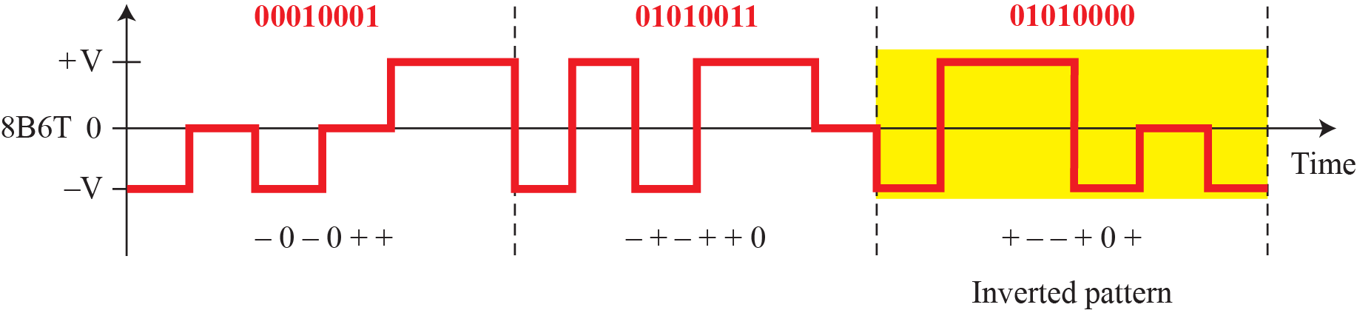
4.1.2 Line Coding Schemes
4. Multilevel Schemes
  ② 8B6T(8 Binary, 6 Ternary)
    Encode 8 bit patterns to 6 signal pattern three level (+V, 0V, -V)
    Number of data patterns : 2⁸ = 256, Signal patterns : 3⁶ = 729
    473(729-256) redundant signal elements are used for synchronization, DC balance, and error detection.
    Consecutive Weight + : invert the signals
    Used with 100BaseT4
2^{m} ≤ L^{n ➔} 2⁸ ≤ 3^{6 ➔} 256 ≤ 729
Weight 0
Weight +
Weight +

Slide 35
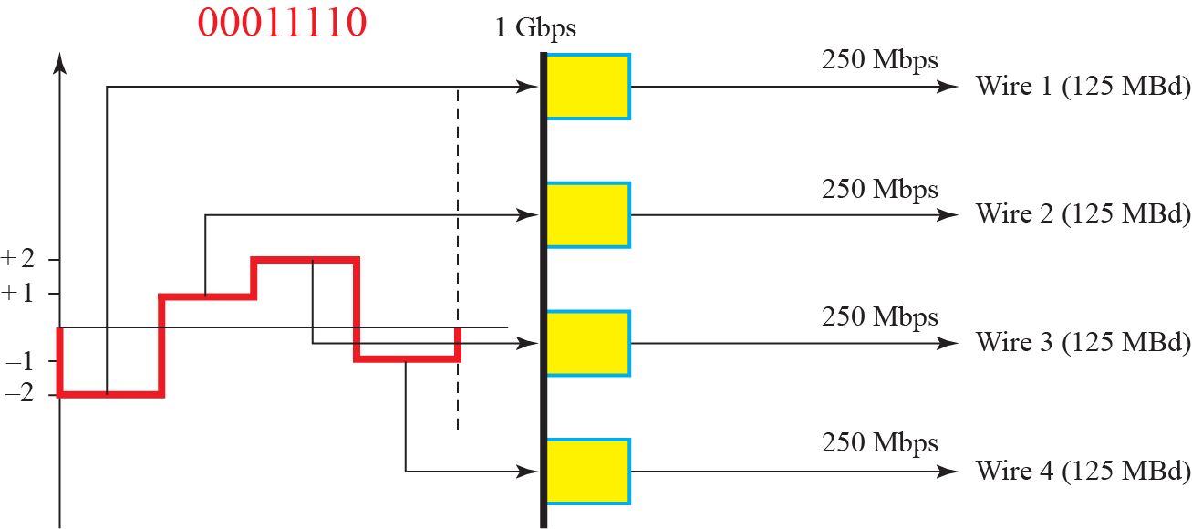
4.1.2 Line Coding Schemes
4. Multilevel Schemes
  ③ 4D-PAM5
    Four-dimensional five-level pulse amplitude modulation
    4D : Data is sent over 4 wires at the same time.
    Five level : -2, -1, 0, 1, 2 (0 level is used for error detection)
    Used with 1Gbps LAN (1000BaseT Giga LAN )
11
01
10
00

Slide 36
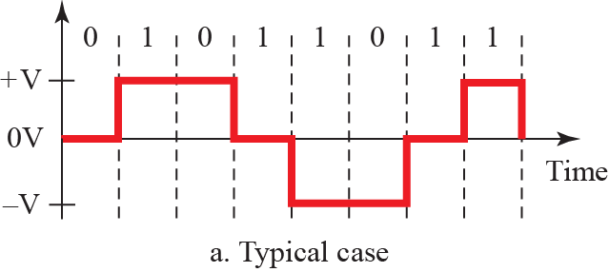
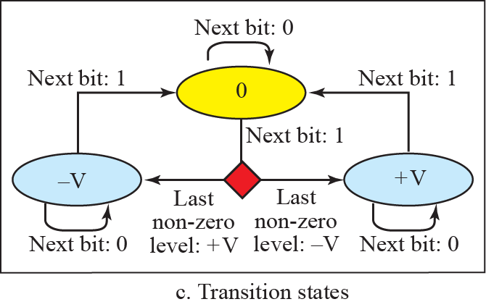
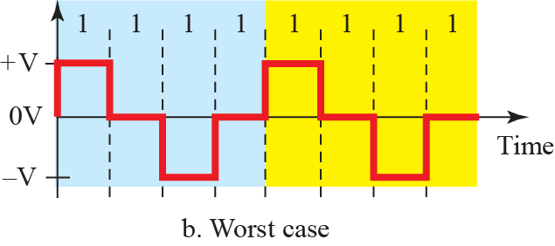
4.1.2 Line Coding Schemes
5. Multi-transition Schemes
  MLT-3(Multiline transmission three level)
    Three signal level (+V, 0V, -V)
    0 : no transition
    1 : +V or -V ➔ 0V transition,
    0V ➔ opposite of the last nonzero level
    Used with 100Mbps copper wire

Slide 37
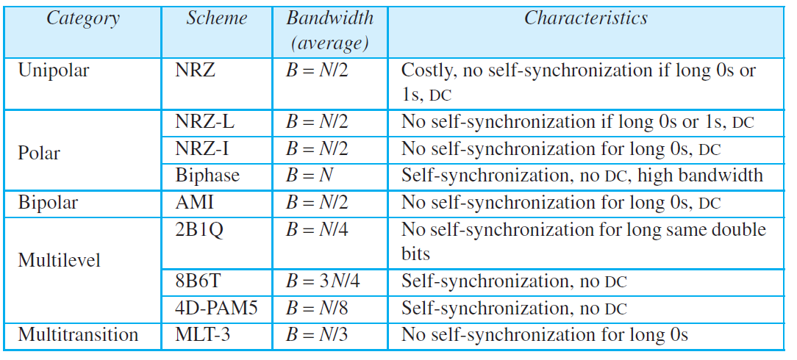
4.1.2 Line Coding Schemes
Summary of Line Coding

Slide 38
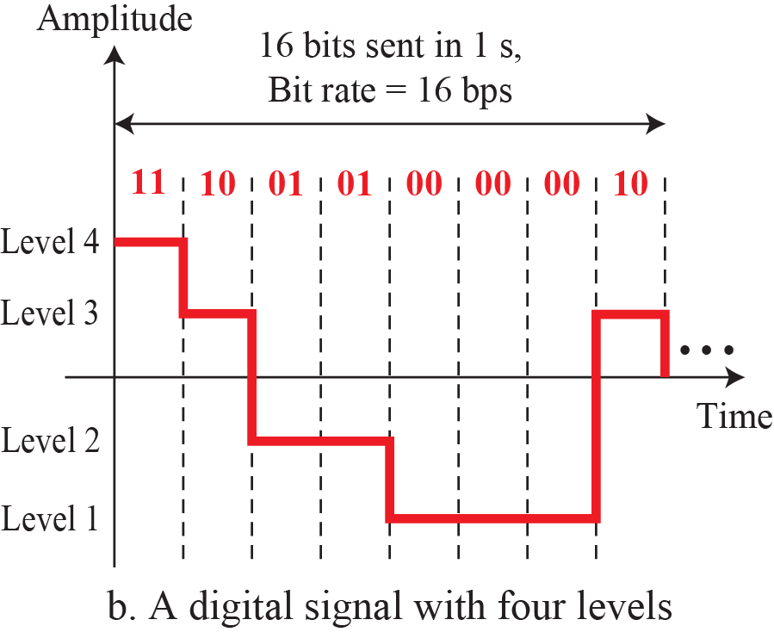
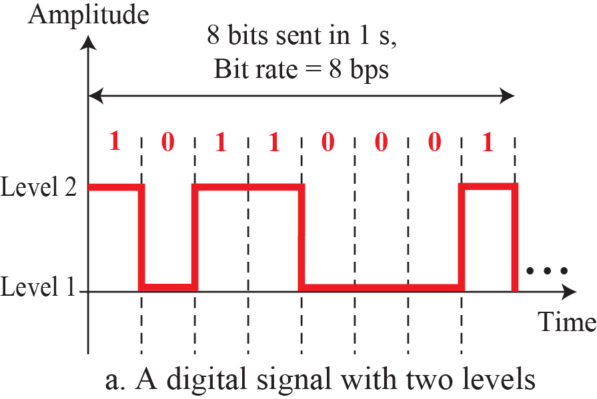
Signal Rate 과 Data Rate
Signal level : 2 level
Data element : 1bit
Signal level : 4 level
Data element : 2bit
Data Rate : 8bps(bit per second)
Signal Rate : 8baud
Data Rate : 16bps(bit per second)
Signal Rate : 8baud

Slide 39
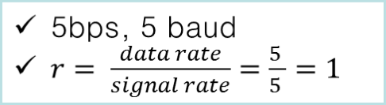

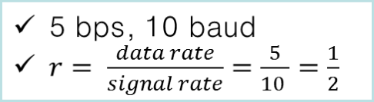
Signal Rate과 Data Rate
1Sec
r = log₂ L

Slide 40
4.1.3 Block Coding
We need redundancy to ensure synchronization and to provide some kind of inherent error detecting.
  Block coding can give us this redundancy and improve the performance of line coding.
Block Coding
  block coding changes a block of m bits into a block of n bits, where n is larger than m.
  It is referred to as an mB/nB encoding technique.
  After the block coding, line coding techniques are applied.

Slide 41

4.1.3 Block Coding
Block Coding Concept
m < n

Slide 42
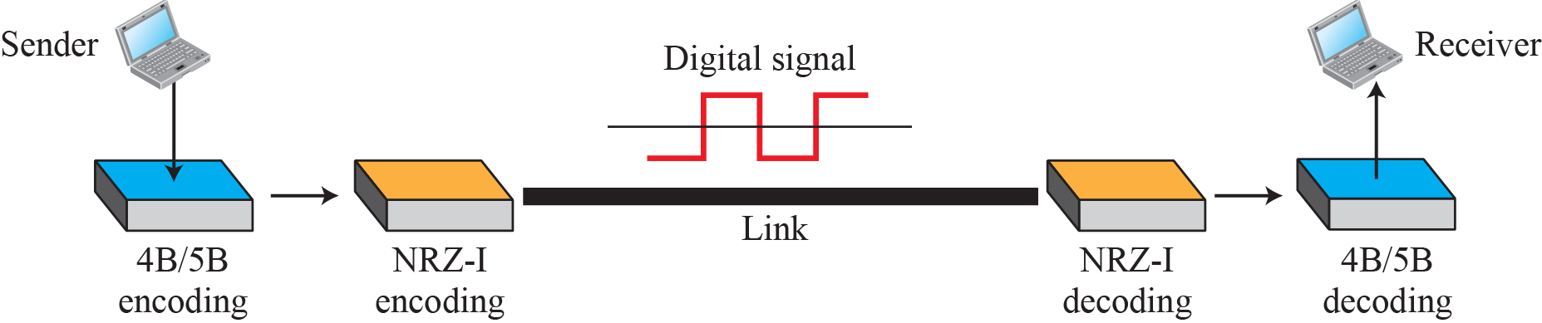

4.1.3 Block Coding
Using block coding 4B/5B with NRZ-I line coding
  NRZ-I has a good signal rate, but it has a synchronization problem at a long sequence of 0s.
  4B/5B (4Binary/5Binary)
    ( 2⁵ = 32 ➔ 2⁴ = 16 )

Slide 43
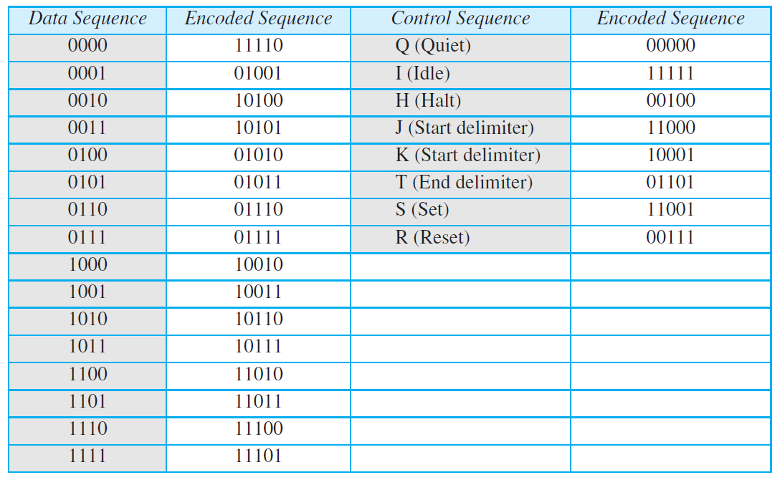
4.1.3 Block Coding
4B/5B Mapping Code
  There is no three consecutive zero(0).
  Number of valid code : 16, control code : 8, unused : 8

Slide 44
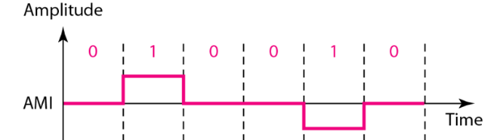
4.1.4 Scrambling
Biphase
  Suitable for dedicated links such as LAN
  Not suitable for long distance,
    because of wide bandwidth requirement.
NRZ-I with Block Coding
  Not suitable for long distance,
    because of DC component.
Bipolar AMI
  A long sequence of 0s upsets the synchronization.
  A solution is substituting long zero-level pulses with combination of other levels.

Slide 45
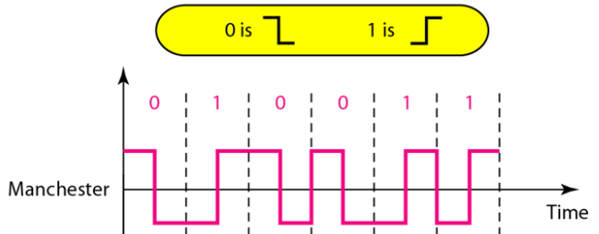
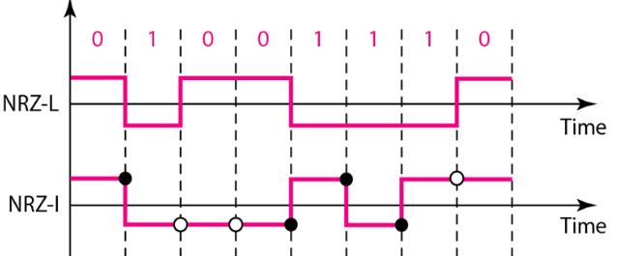
Example 4.5
We need to send data at a 1Mbps rate.
What is the minimum required bandwidth, using a combination of 4B/5B and NRZ-I or Manchester coding?
Solution
First 4B/5B block coding increases the bit rate to 1.25Mbps.
1 bit is added to every 4 bit. 25% is added to 1Mbps.
The minimum bandwidth :
- 4B/5B & NRZ-I coding : N/2 or 625kHz.
- Manchester coding : 1MHz.
4B/5B & NRZ-I coding : lower bandwidth, DC component problem.
Manchester coding : higher bandwidth, no DC component problem.

Slide 46
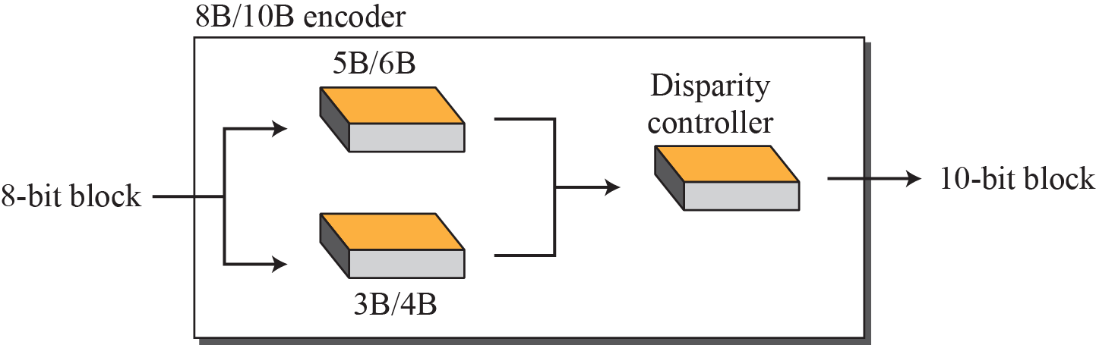
4.1.4 Scrambling
8B/10B
  A combination of 5B/6B and 3B/4B
  Five most significant bits are fed into 5B/6B, three least significant bits are fed into 3B/4B.
  Number of unused code : 2¹⁰ – 2⁸ = 768

Slide 47

4.1.4 Scrambling
Scrambling
  A technique used for digital-to-digital conversion in long-distance transmission.
  In Scrambling, modified AMI schemes are used for digital transmission to maintain system synchronization.
  Two common scrambling techniques : B8ZS, HDB3.

Slide 48

4.1.4 Scrambling
Scrambling
  Bipolar with eight-zero Substitution (B8ZS)
    B8ZS substitutes eight consecutive zeros with 000VB0VB.
    "B" denotes bipolar with the opposite polarity to the preceding mark, while "V" denotes a bipolar violation mark.
    Depending on the polarity of the preceding mark, that could be 000+−0−+ or 000−+0+−.

Slide 49
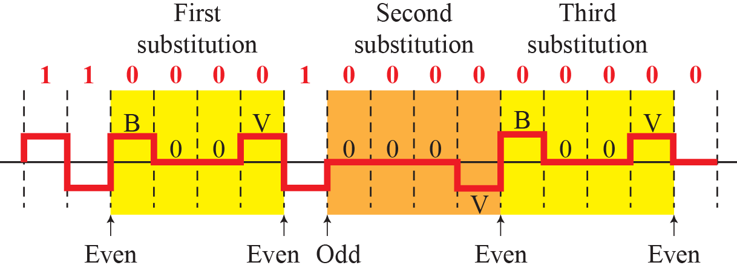
4.1.4 Scrambling
Scrambling
  HDB3(High-density bipolar 3-zero)
    HDB3 substitutes four consecutive zeros with 000V or B00V depending on the number of nonzero pulses after the last substitution.
      - If the number of nonzero pulses is odd, 000V
      - If the number of nonzero pulses is even, B00V
    which makes the total number of nonzero pulses even.

Slide 50
4.2 Analog to Digital Conversion
A digital signal is superior to an analog signal.
The tendency today is to change an analog signal to digital data.
Topics discussed in this section:
4.2.1 Pulse Code Modulation (PCM)
4.2.2 Delta Modulation (DM)

Slide 51
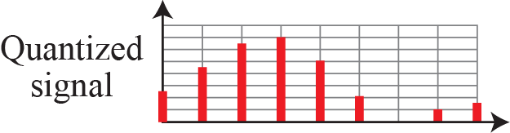




4.2.1 Pulse Code Modulation(PCM)
Pulse Code Modulation (PCM) changes an analog signal to digital data (digitization).
A PCM encoder has three processes.

Slide 52

4.2.1 Pulse Code Modulation(PCM)
Pulse Code Modulation (PCM)
  The analog signal is sampled. (Sampling)
  The sampled signal is quantized. (Quantizing)
  The quantized values are encoded as streams of bits. (Encoding)

Slide 53



4.2.1 Pulse Code Modulation(PCM)
Sampling
  The analog signal is sampled every T_{S}.(T_{S} is Sample period)
  Three different sampling

Slide 54


4.2.1 Pulse Code Modulation(PCM)
Sampling Rate
According to the Nyquist theorem, the sampling rate must be
at least 2 times the highest frequency contained in the signal.

Slide 55
Example 4.6
Three sampling rates of a simple sine wave :
  fs = 4f (2 times the Nyquist rate)
  fs = 2f (Nyquist rate)
  fs = f (one-half the Nyquist rate).
Subsequent recovery of the signal
  Sampling at the Nyquist rate : create a good approximation of the original sine wave. (part a).
  Oversampling : the same approximation, but it is redundant and unnecessary. (part b)
  Sampling below the Nyquist rate : does not produce a signal that looks like the original sine wave. (part c)

Slide 56



Example 4.6
Figure 4.24: Recovery of a sine wave with different sampling rates.

Slide 57



Example 4.8 Sampling of clock with only one hand

Slide 58
Example 4.8 Example 4.9
Example 4.8
An example related to Example 4.7 is the seemingly backward rotation of the wheels of a forward-moving car in a movie.
This can be explained by undersampling.
A movie is filmed at 24 frames per second.
If a wheel is rotating more than 12 times per second, the undersampling creates the impression of a backward rotation.
Example 4.9
Telephone companies digitize voice by assuming a maximum frequency of 4000 Hz.
The sampling rate therefore is 8000 samples per second.

Slide 59
Example 4.10
A complex low-pass signal has a bandwidth of 200 kHz. What is the minimum sampling rate for this signal?
Solution
  The bandwidth of a low-pass signal is between 0 and f, where f is the maximum frequency in the signal.
  Therefore, we can sample this signal at 2 times the highest frequency (200 kHz).
  The sampling rate is therefore 400,000 samples per second.

Slide 60
Example 4.11
A complex bandpass signal has a bandwidth of 200 kHz. What is the minimum sampling rate for this signal?
Solution
  We cannot find the minimum sampling rate in this case because we do not know where the bandwidth starts or ends.
  We do not know the maximum frequency in the signal.

Slide 61

4.2.1 Pulse Code Modulation(PCM)
Figure 4.26: Quantization and encoding of a sampled signal

Slide 62
Example 4.12
What is the SNR_{dB} in the example of Figure 4.26?
Solution
  SNR_{dB} = 6.02n_{b} + 1.76 dB
  We can use the formula to find the quantization.
  We have eight levels and 3 bits per sample, so n_{b} is 3.
  SNR_{dB} = 6.02(3) + 1.76 = 19.82 dB.
  Increasing the number of levels increases the SNR.

Slide 63

Example 4.13
A telephone subscriber line must have an SNR_{dB} above 40.
What is the minimum number of bits per sample?
Solution
  We can calculate the number of bits as
  Telephone companies usually assign 7 or 8 bits per sample.

Slide 64

Example 4.14
We want to digitize the human voice.
What is the bit rate, assuming 8 bits per sample?
Solution
  The human voice normally contains frequencies from 0 to 4000 Hz.
  So the sampling rate and bit rate are calculated as follows:

Slide 65
4.2.1 Pulse Code Modulation(PCM)
Encoding
  Each sampled data can be changed to an n_{b} bit code word.
  The number of bit for each sample is determined from the number of quantization levels.
  Bit rate = Sampling rate x number of bit per sample
  = f_{s} x n_{b}
      n_{b} = log₂L
      If L is 8, n_{b} is 3.

Slide 66




4.2.1 Pulse Code Modulation(PCM)
The components of a PCM decoder

Slide 67


4.2.1 Pulse Code Modulation(PCM)
PCM Bandwidth
  Minimum bandwidth of a line-encoded signal
    If 1/r is 1, c = ½ ,
n_{b} is number of bit per sample or number of level per bit.

Slide 68
Example 4.15
We have a low-pass analog signal of 4 kHz.
  If we send the analog signal, we need a channel with a minimum bandwidth of 4kHz.
  If we digitize the signal and send 8 bits per sample, we need a channel with a minimum bandwidth of 8 × 4kHz = 32kHz.

Slide 69



4.2.1 Pulse Code Modulation(PCM)
Maximum Data Rate of a Channel (bps)
Minimum Required Bandwidth

Slide 70

PCM 요약

Slide 71

4.2.2 Delta Modulation(DM)
PCM
  It finds the value of the signal amplitude for each sample.
DM
  It finds the change from the previous sample.
  There are no code words here; bits are sent one after another.

Slide 72

4.2.2 Delta Modulation(DM)
Modulator
  The process records the small positive or negative changes, called delta (δ) :
    The delta is positive, the process records a 1.
    The delta is negative, the process records a 0.

Slide 73

4.2.2 Delta Modulation(DM)
Demodulator

Slide 74

4.3 Transmission Modes
Do we send 1 bit at a time; or do we group bits into larger groups and, if so, how?
The transmission of binary data across a link can be accomplished in either parallel or serial mode. and isochronous.

Slide 75



4.3.1 Parallel Transmission
Parallel Transmission
  By grouping bits, we can send data n bits at a time.
    It is needed n wires to send n bits at one time.

Slide 76



4.3.1 Parallel Transmission
Serial Transmission
  It is the process of sending data one bit at a time over a communication channel.
  Asynchronous Transmission
    It uses start and stop bits to signify the beginning and end of transmission
  Synchronous Transmission
    It synchronizes transmission speeds at both the receiving and sending end of the transmission using clock signals.
    The clock may be a separate signal or embedded in the data.

Slide 77




4.3.2 Serial Transmission
Asynchronous Transmission
  It sends 1 start bit (0) at the beginning and 1 or more stop bits (1s) at the end of each byte.
  There may be a gap between each byte.
Asynchronous here means “asynchronous at the byte level,”but the bits are still synchronized; their durations are the same.

Slide 78
4.3.2 Serial Transmission
Asynchronous Transmission
  NO synchronization : No need to send idle characters.
  Transmitter and receiver operate independently.
    Transmitter can send data at any time.
    Receiver is always ready to accept data.
  Requires a start and stop bit to identify each byte of data.
  How does receiver know that data is arriving?
    If the line is idle, it is sending a constant‚ 1 (mark state)
    The receiver is able to recognize a jump from 1 to 0 with the start bit and is alerted that data is about to be sent.
Stop Bits (2)
Data
Bit 1
Data
Bit 3
Data
Bit 6
Parity
Bit
HIGH
LOW
Start
Bit
Data
Bit 0
Data
Bit 2
Data
Bit 4
Data
Bit 5
Data
Bit 7

Slide 79

4.3.2 Serial Transmission
Asynchronous Transmission
  Bits are transmitted in a specified format.
  Defined by settings on transmitter and receiver:
    Start Bit
    Data Bits
    Parity Bits
    Stop Bits

Slide 80



4.3.2 Serial Transmission
Synchronous Transmission
  Transmitter and receiver have their clocks synchronized.
  Data rates are dependent on clock rates.
  Continuously transmitting characters to remain in sync.
It sends bits one after another without start or stop bits or gaps.
It is the responsibility of the receiver to group the bits.

Slide 81
4.3.2 Serial Transmission
Comparison of Synchronous and Asynchronous Transmission
 | Advantages | Disadvantages
Asynchronous Transmission | Simple at both sides Cheap, because it requires less hardware Setup is faster For the applications where messages are generated at irregular intervals, ( keyboard ) | Large relative overhead lesser throughput
Synchronous Transmission | Lower overhead Greater throughput | Slightly more complex Hardware is more expensive

Slide 82

4.4 Summary
Digital to Digital Conversion
  Line coding : Conversion of digital data to digital signals
    Unipolar, NRZ(NRZ-L,NRZ-I), Biphase (Manchester, Differential Manchester), Bipolar AMI, 2B1Q
  Block coding : changes m bits block into n bits block.
  Scrambling : for digital transmission in long-distance.
Analog to Digital Conversion
  Pulse Code Modulation (PCM)
    Sampling → Quantization → Encoding
  Delta Modulation
    Quality is not of primary importance.

Slide 83
4.4 Summary
Transmission Modes
  Parallel Transmission
  Serial Transmission
    Synchronous transmissions are synchronized by an external clock.
    Asynchronous transmissions are synchronized by special signals along the transmission medium.

